Slide 1
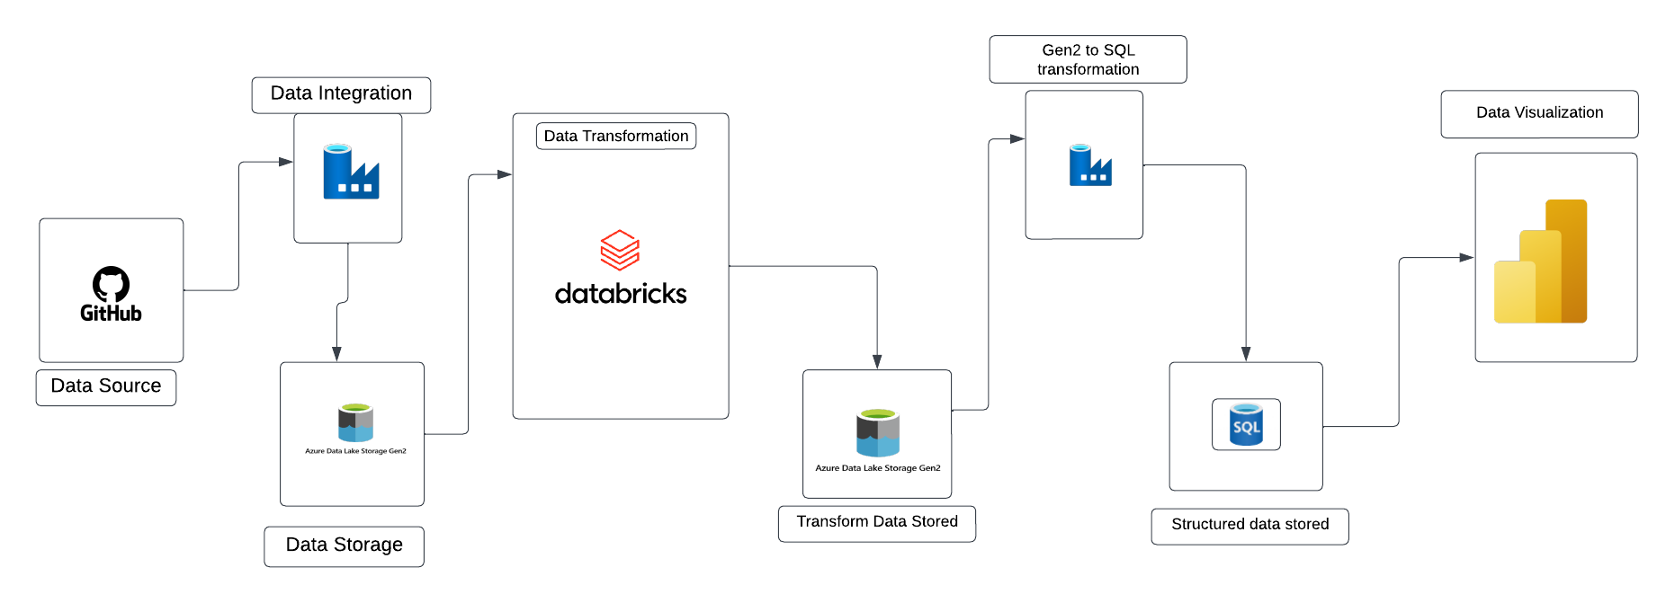
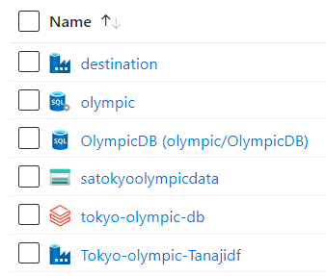
Tokyo Olympic Data Engineer to Data Analyst Project
Architecture
In this architecture I have changed unstructured data into structured format and store in DB location and based on this created Power BI report
Azure Resources

Slide 2
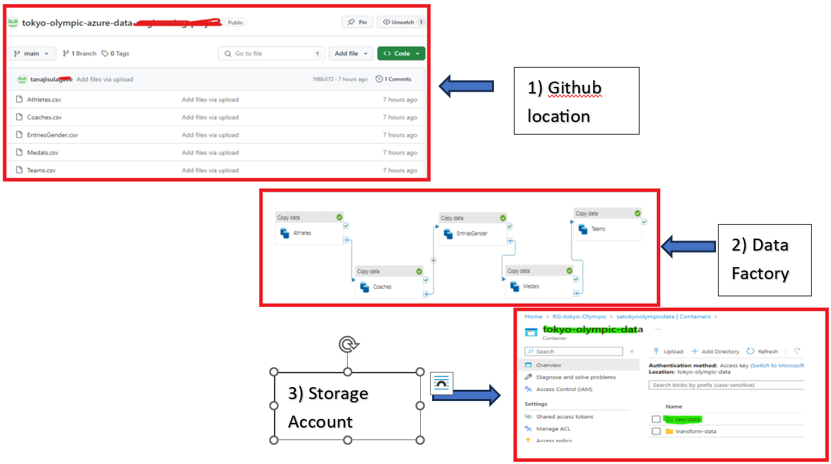
Extracted all the files from Github account and stored in Azure storage account (gen 2) using ADF pipelines. (container Name :- Raw_Data)

Slide 3
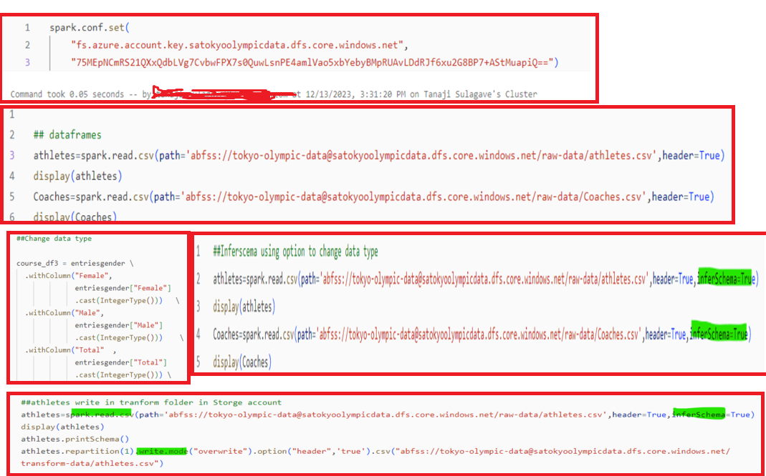
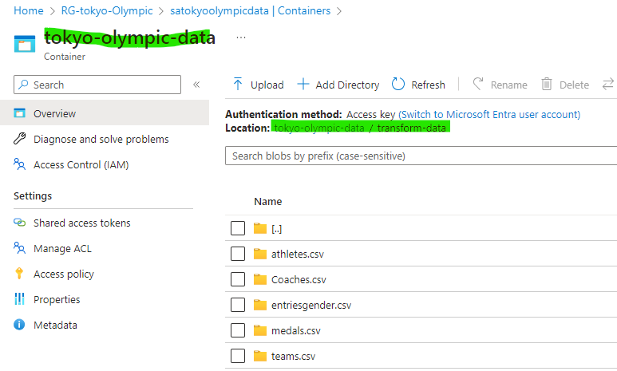
Data Transformation :- Connect Gen 2 to Azure DB and Done transformation with creating notebooks and Transformed data stored in Storage Account (container Name :- Transform_Data) Note:- ADB to Gen2 Connection using Account Key

Slide 4
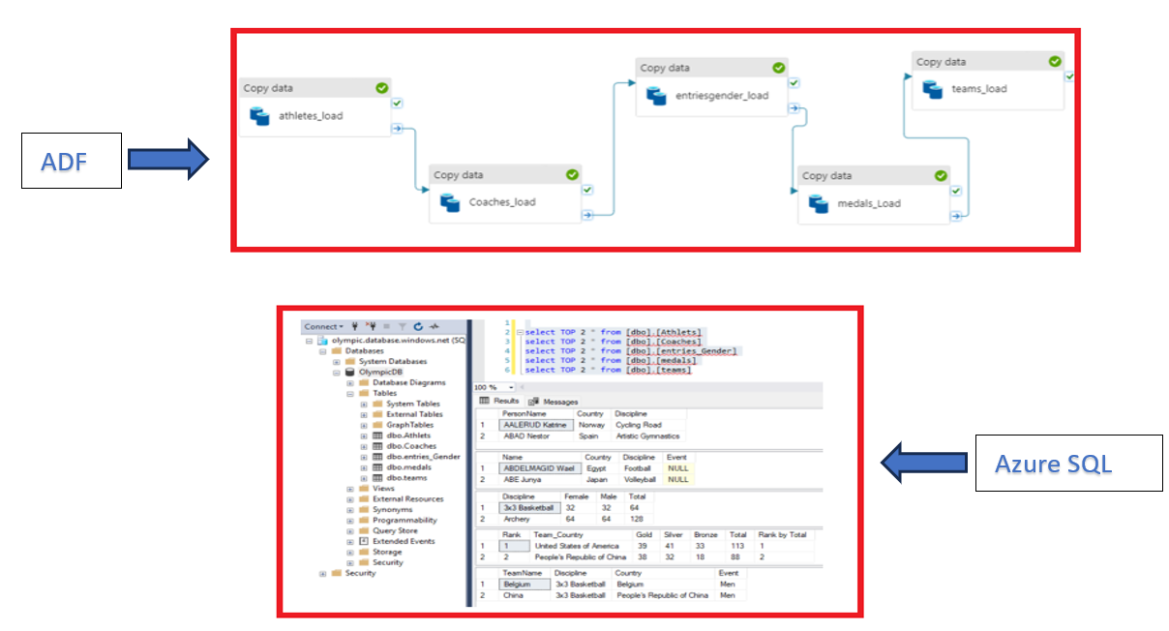
Using Data factory created ADF pipeline for store the transformed/ structured data in Azure SQL server

Slide 5
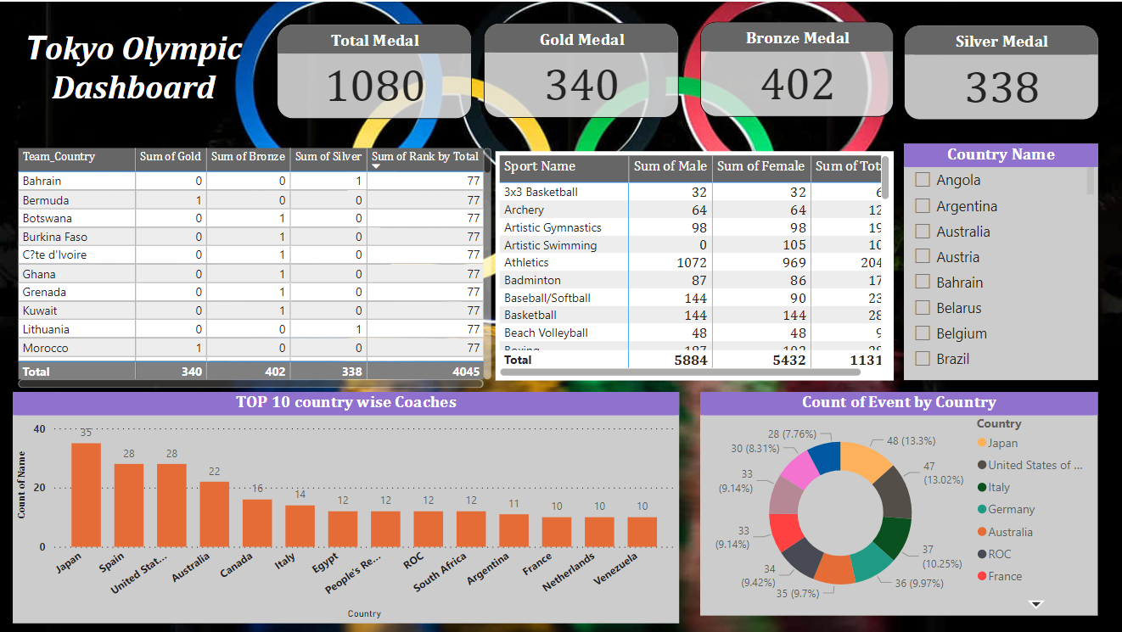
Using Azure SQL connection created Power BI dashboard for visualizing the key insights

